Slide 1
Final Project: Analysis of influencing factors for diabetes By Aaron Mahalanabis
Analyse a data sample of diabetic and healthy patients across various potential influencers like pregnancies, glucose, blood pressure, skin thickness, insulin, BMI, age and diabetic pedigree function.

Slide 2
Objective of Study:
Analyse healthy and diabetic population separately in the sample dataset to discover any patterns in the potential influencers
Find correlation of potential influencers in order to help in predicting potential risk of diabetes for early precaution and preventive measures

Slide 3
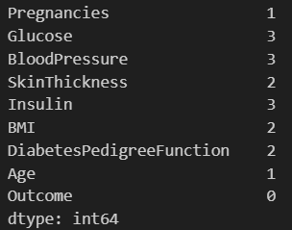
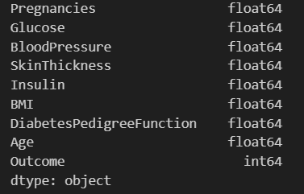
Description of dataset:
Data context
This dataset is originally from the National Institute of Diabetes and Digestive and Kidney Diseases. The objective of the dataset is to diagnostically predict whether or not a patient has diabetes, based on certain diagnostic measurements included in the dataset. Several constraints were placed on the selection of these instances from a larger database. In particular, all patients here are females at least 21 years old of Pima Indian heritage. The dataset consists of several medical predictor variables and one target variable, Outcome. Predictor variables includes the number of pregnancies the patient has had, their BMI, insulin level, age, and so on.
Number of records : 768
Missing Values:
Datatypes:
The missing values were imputed with mean of their respective categories

Slide 4
EXPLORATORY DATA ANALYSIS
Ref: https://www.kaggle.com/code/vincentlugat/pima-indians-diabetes-eda-prediction-0-906

Slide 5
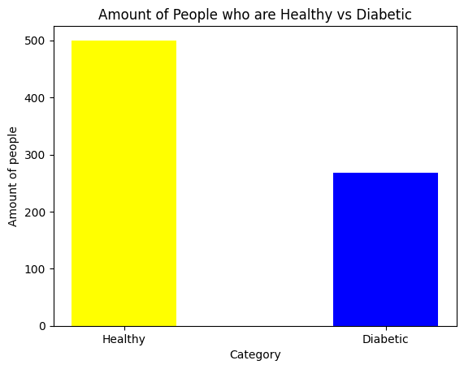
Question 1: What is the proportion of Healthy and Diabetic people in the sample data?
34.9% of the sample population were with diabetic condition

Slide 6
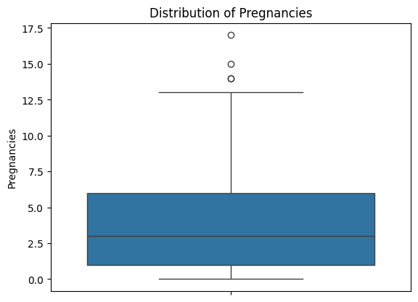
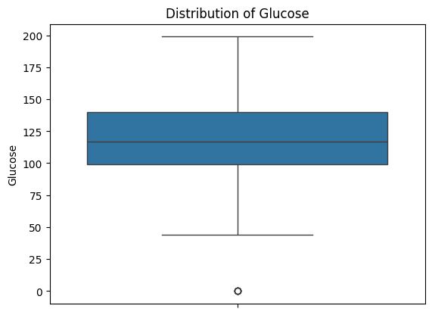
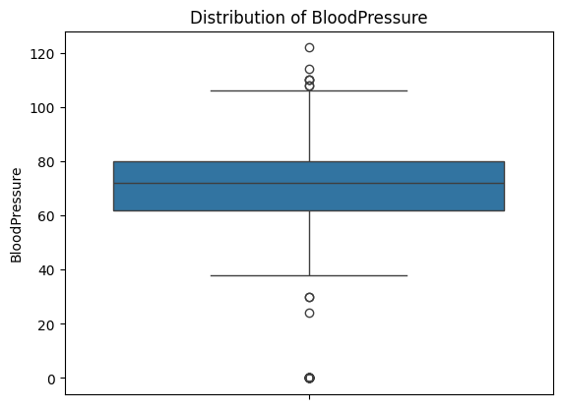
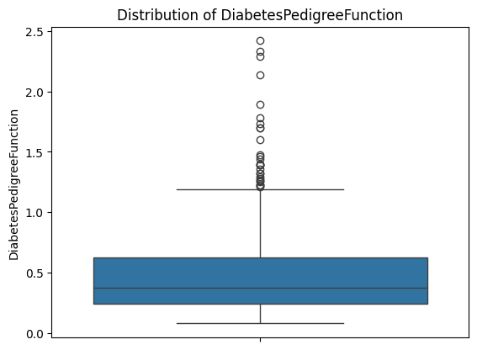
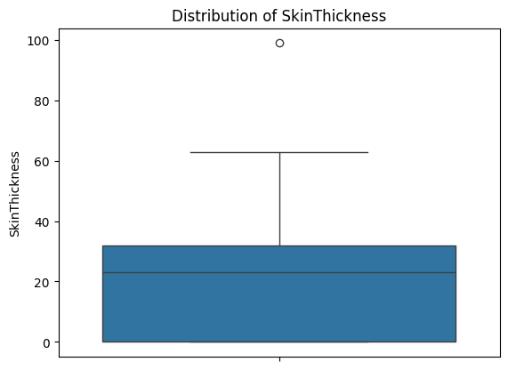
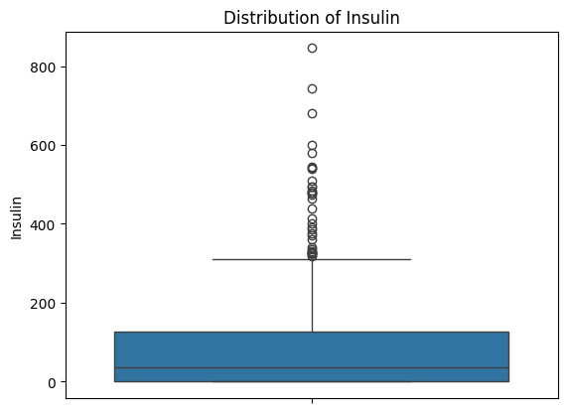
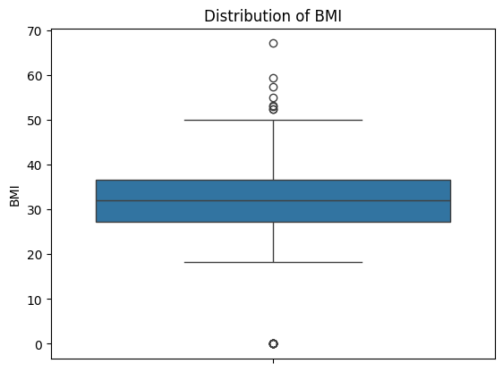
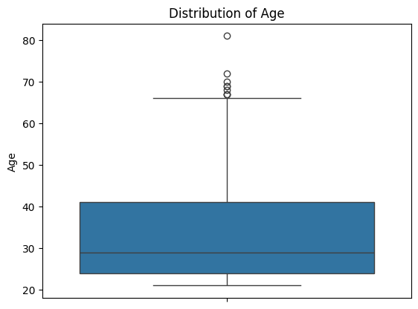
Question 2: What is the distribution of the potential influencers to diabetes?
Diabetes pedigree function, insulin, BMI and age have outliers.

Slide 7
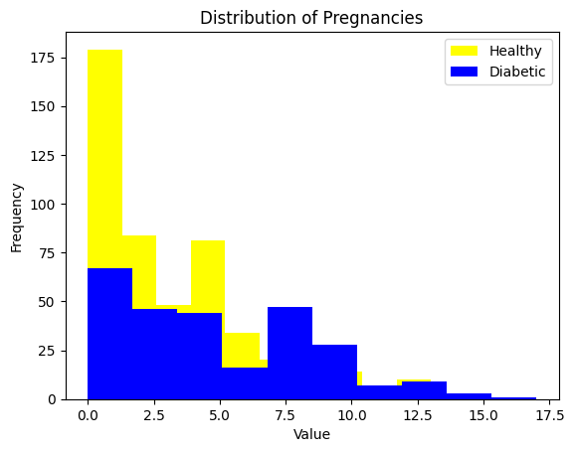
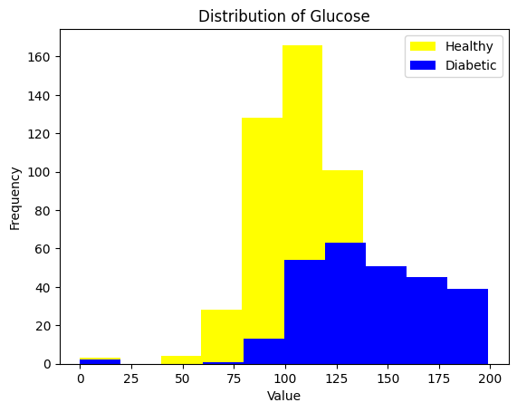
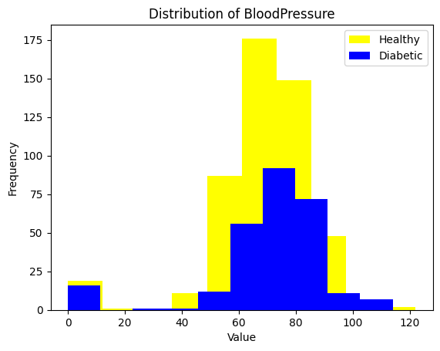
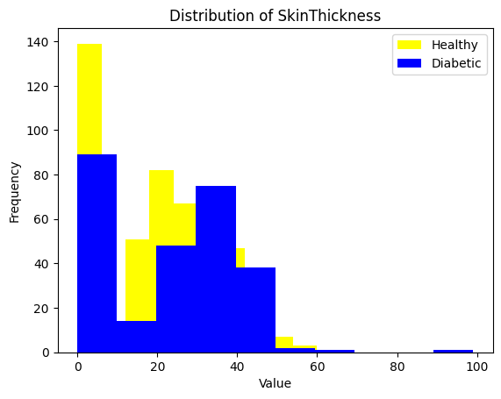
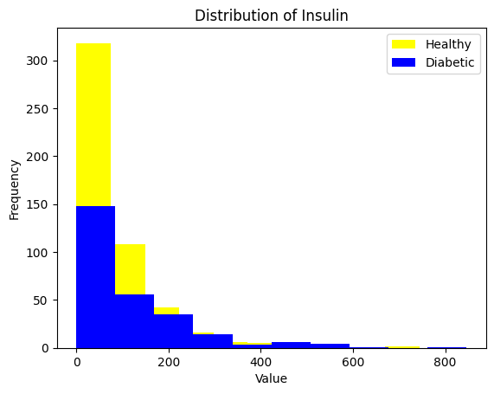
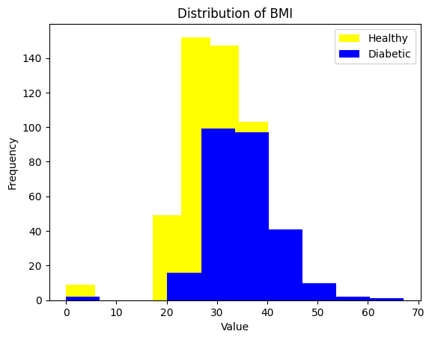
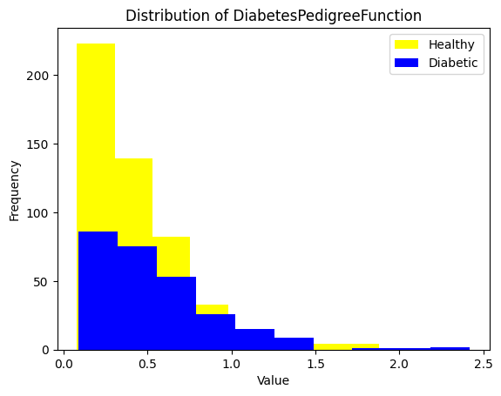
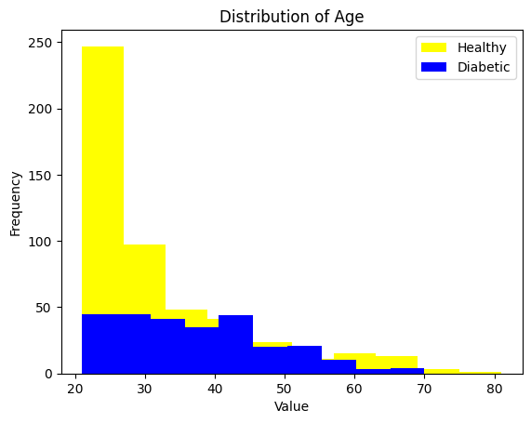
Question 3: Do the potential influencers vary in distribution across healthy and diabetic population?
Glucose and count of previous pregnancies show a distinct higher value for diabetic conditions. This can be further analysed by comparing the means of the healthy and diabetic population

Slide 8
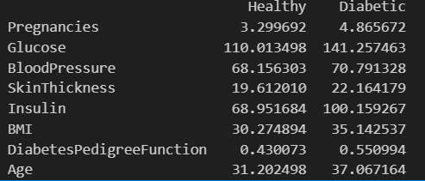
Question 3: Do the potential influencers vary in distribution across healthy and diabetic population?
Glucose and count of previous pregnancies show a distinct higher value for diabetic conditions. This can be further analysed by comparing the means of the healthy and diabetic population
Comparison between healthy and diabetic population also shows higher mean values for :
Pregnancies
Glucose
Insulin
BMI
Age
Skin thickness, diabetic pedigree function and blood pressure do not show any major deviation between the two populations.

Slide 9
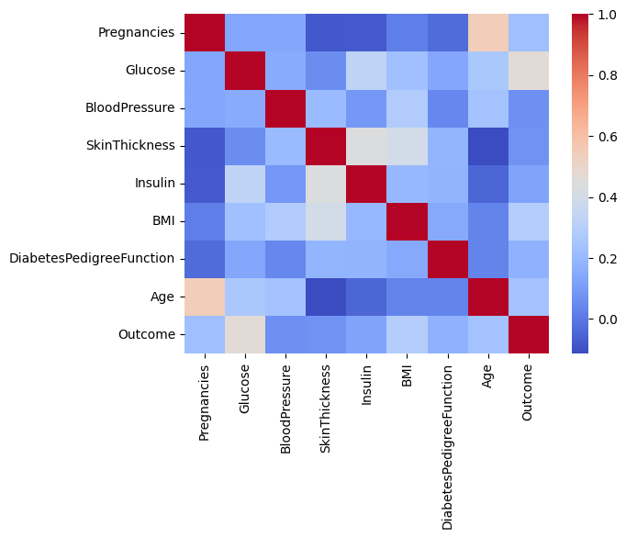
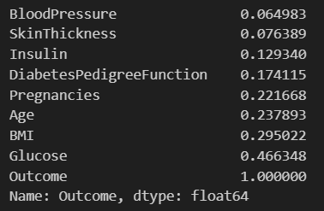
Question 4: Are there significant correlations between the influencers and diabetes outcome?
The ranked correlation shows higher correlation of glucose, BMI, Age and Pregnancies to potential diabetic condition

Slide 10
Inference from the above analysis:
Objective | Inference from data analysis
Discover any patterns in the potential influencers | Comparison between healthy and diabetic population also shows higher mean values for Pregnancies, Glucose, Insulin, BMI and Age No significant difference in distribution of Blood Pressure, Skin Thickness and Diabetes Pedigree Function between healthy and diabetic population was seen in this sample.
Find correlation of potential influencers in order to help in predicting potential risk of diabetes for early precaution and preventive measures | Glucose, BMI, Age, Insulin and Pregnancies show higher correlation to diabetic outcome and have higher mean values in diabetic population in the sample.

Slide 11
Further possible work:
A classification model can be built to predict the risk of diabetes in new patients.
Steps:
Treat the null values by replacing them with the mean of all values in that category.
Normalize the distribution of the independent variables.
Apply feature scaling.
Split the sample data into Training and Test set.
Train the data on the Training set.
Find the accuracy of the model after testing it on the Test set.
Different classification models can be tested for example: Logistic Regression, K-Nearest Neighbours, SVM, Decision Tree, Random Forest Regression, etc.

Slide 12
Thank You

